Slide 1
Human Resource Management Project
K14T – Team 05

Slide 2
AGENDA
Project Overview
Methodology
Project Plan
Product Overview
Status -- Deliverables Checklist
Team Reflection
Notes:
Remember to put name of the presenters into this slide

Slide 3
Project Overview
Capstone project – Final project
Plan and conduct real project
Working through all aspects of development progress
Human resource planning and managing department
The needs of using a HRM software
Notes:
Learning how to plan and conduct a real project successfully.
Working through all the aspects of a real world project.
nói về khách hàng, context tại sao có dự án này
Traditionally, a capstone project is a final work before students graduate from college. For computer science and software engineering students, many capstones are “real projects” given by companies in the software industry. In these project, students have to apply all the knowledge that they have learned throughout their four years in college to solve real problem. Capstone projects are often intensive, requiring significant effort in both planning and implementing

Slide 4
AGENDA
Project Overview
Methodology
Project Plan
Product Overview
Status -- Deliverables Checklist
Team Reflection

Slide 5
Product Overview
Client: Human Resource Planning and Managing Department of VLU
Responsibility:
Personal information management
Employee labor contract management
Recruitment & training processing
Payroll
The needs of using a software
Notes:
Product overview will describe statement of work: The purpose of statement of work is to describe the relationship between client and team.
General project description and outline. Client
Description of client and domain
Description team
General responsibilities of team and client

Slide 6
Product Overview
Lead Requirement
Quyet Nguyen
Lead Architect
Tuong Nguyen
Lead Detail Design
Dang Nguyen
Lead Test
Tung Nguyen
Nguyen Dinh
Tan Tran
Loc Phan
Project Manager
Nhung Huynh
Technical Lead Tan Tran
Development Team
Notes:
Product overview will describe statement of work: The purpose of statement of work is to describe the relationship between client and team.
General project description and outline. Client
Description of client and domain
Description team
General responsibilities of team and client

Slide 7
Product Overview
Customers’ responsibility
Provide requirements clearly
Provide required artifacts immediately
Meeting with team regularly
Development team’s responsibility
Deliver a quality product
Complete product on time
Support for customers responsibly
Notes:
Responsibility of customers to Dev team
Responsibility of Dev team to customers

Slide 8
Product Overview
Recruitment
Personal Information Management
Labor Contract Management
Insurance Management
Labor Management
Assessment Management
Income Management
Notes:
Product overview will describe statement of work: The purpose of statement of work is to describe the relationship between client and team.
General project description and outline
Description of client and domain
Description team
General responsibilities of team and client

Slide 9
AGENDA
Methodology
Project Plan
Product Overview
Status -- Deliverables Checklist
Team Reflection

Slide 10
MODEL AND
REASON CHOOSE IT

Slide 11
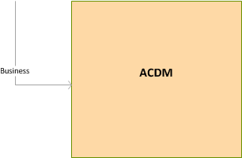

Slide 12
Reason choose Waterfall model
Simple to implement
Easy to manage, each phase has specific deliverables.
The amount resource to implement this model are minimal
Works well for smaller projects and completed once at a time.
Documentation is produced at every stage of software’s development.

Slide 13
Reason choose ACDM framework
Provides techniques and structure for designing the architecture
Using the architectural design to guide the programmatic aspects of a project
Guides project planning, tracking, and construction

Slide 14
Reason integrate with Incremental-model
Detail design, programming, testing
Easy to generates working software quickly and early during the software life cycle
Less costly to change detail design, program because team member not good about detail design and programming
Easy to test and debug
Easy manage

Slide 15
ACDM Role
Role | Responsibility | Name
Managing Engineering | Coordinating the overall system design and development effort | Nhung Huynh
Chief Architect | Architectural design | Tuong Nguyen
Chief Scientist | Planning, coordinating, tracking, experiments used to refine the design | Tan Tran
Support Engineer | Set up and maintains the design team’s support tools and environments | Loc Phan
Requirements Engineer | Coordinating the gathering and tracking of the architectural drivers | Quyet Nguyen
Quality Process Engineer | Ensure that ACDM and other defined processes are follwed as prescribed to ensure project quality goals are met | Tung Nguyen
Production Engineers | Focus on detailed design, implementation, and integration of the elements to compose the system | Dang Nguyen

Slide 16


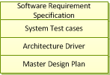

Slide 17


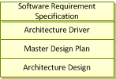
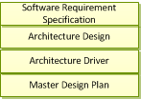

Slide 18


Slide 19




Slide 20
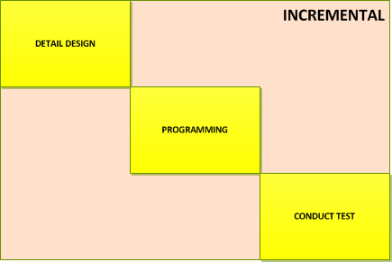



Slide 21
AGENDA
Methodology
Project Plan
Status -- Deliverables Checklist
Team Reflection

Slide 22
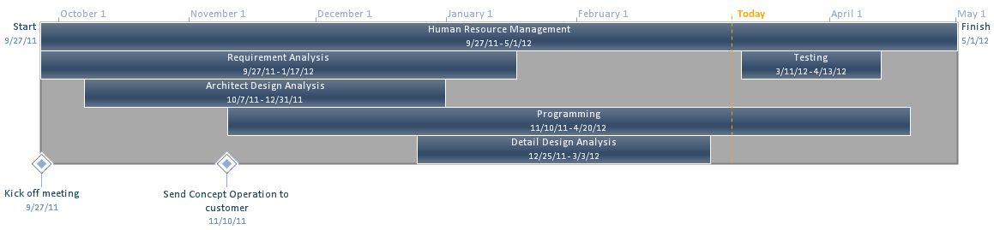
Project Plan -- Overview
Notes:
Project planning should describe how the team will:
Work breakdown structures
Task estimation
Chart – for comparing actual with plan
Process should describe:
Project process: reason why team can select it
Process for each stage.
Số người, thời gian trong từng giao đoạn

Slide 23
Project Plan -- Process
Notes:
Project planning should describe how the team will:
Work breakdown structures
Task estimation
Chart – for comparing actual with plan
Process should describe:
Project process: reason why team can select it
Process for each stage.

Slide 24
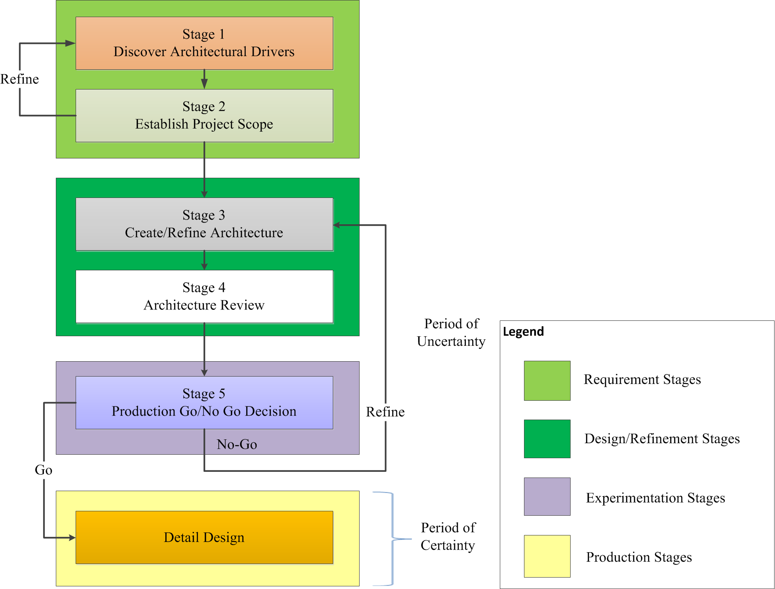
Project Plan -- Process
Notes:
Project planning should describe how the team will:
Work breakdown structures
Task estimation
Chart – for comparing actual with plan
Process should describe:
Project process: reason why team can select it
Process for each stage.

Slide 25
Project Plan -- Process
Definition
Analysis
Evaluation
Detail Design
Review
Notes:
Project planning should describe how the team will:
Work breakdown structures
Task estimation
Chart – for comparing actual with plan
Process should describe:
Project process: reason why team can select it
Process for each stage.

Slide 26
Project Plan -- Process
ACDM
Test Planning
Test Development
Test Execution
Defect Reporting
Retest Defects
Product Delivery
Notes:
Project planning should describe how the team will:
Work breakdown structures
Task estimation
Chart – for comparing actual with plan
Process should describe:
Project process: reason why team can select it
Process for each stage.

Slide 27
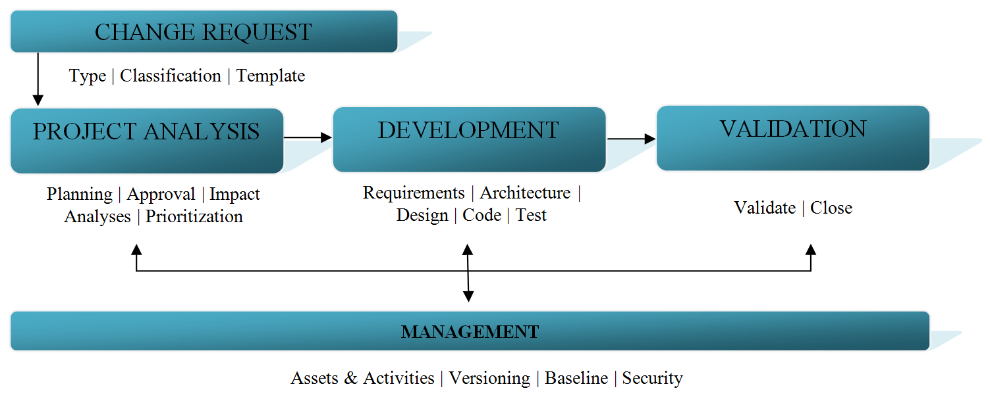
Configuration Management
Notes:
Project planning should describe how the team will:
Work breakdown structures
Task estimation
Chart – for comparing actual with plan
Process should describe:
Project process: reason why team can select it
Process for each stage.

Slide 28
AGENDA
Status -- Deliverables Checklist
Team Reflection
Project Plan

Slide 29
Status – Deliverables Checklist
Notes:
All the documents throughout development phases:
Project performance measurement
3. Requirements
Team should address two documents: concept operation and SRS
4. Designs
Team should address:
Architecture design
Detail design (optional)
5. Test plan
Test plan should address:
Estimate for how much time will be devoted to test
Test schedules
Resource require (user, environment, equipment, so forth)
Unit, integration, deployment testing
Product or system test
Test coverage

Slide 30
Status – Deliverables Checklist
Requirement:
Concepts of Operation
Software Requirement Specification
Design:
HRM Architecture Driver
HRM Architecture Design
Notes:
All the documents throughout development phases:
Project performance measurement
3. Requirements
Team should address two documents:
concept operation: a communication channel among team members, stakeholders to stakeholders and
SRS:
4. Designs
Team should address:
SAD
Architecture design

Slide 31
Status – Deliverables Checklist
Test Plan
Completed time: 12/30/2011 to 03/04/2012
Test Phases:
Unit test
Integration testing
System testing
Acceptance testing
Notes:
Hardware (PC / Laptop)
Hard disk free space: About 2 GB
Memory: more than 512 MB free memory with default cache settings
CPU: Equal or more than Pentium 4-2.0 GHz
Software:
Windows XP SP2, Windows Vista, Windows 7
C #, MS SQL Server 2005, Microsoft Visual Studio 2010
Using Internet Explorer browser to test system testing

Slide 32
AGENDA
Status
Team Reflection

Slide 33
Team Reflection
Measure working progress and make it better
How to deal with customers’ changes
How to get accustomed to using new technology
Understand what a real project is
Notes:
I1: take more attention to effort log and improve each and every team member productivity so that we can work better. That is: update personal time log regularly, and actually use them
I2: Changes are very arrogant in our project. Customers still want to change after the product has been designed. In addition, we do not have out voice in negotiating with customers since they are working
I3: throughout all the projects in 4 years, we always work with new technology. Therefore, step by step, we know how to adapt new technologies as quickly as possible.
I4: the importance of changes, risk, requirement, what a real customer is
Lack of knowledge about HR business => problems to elicit requirements, Architect: Utilize Quality

Slide 34
THE END.
THANKS
FOR
YOUR
ATTENDANCE

Slide 35
MANAGE RISK
Total 39 risk
Include:

Slide 36
RISK PROCESS
RISK MANAGEMENT PLANNING
RISK IDENTIFICATION
RISK RESPONSE PLANNIG
RISK MONITORING & CONTROL
QUALITATIVE RISK ANALYSIS
QUANTITATIVE RISK ANALYSIS

Slide 37
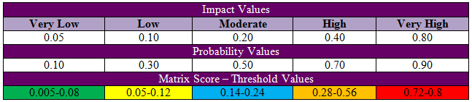
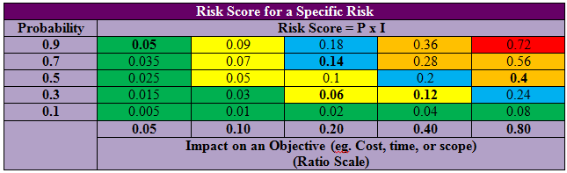

Slide 38
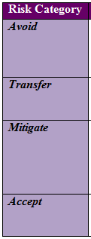
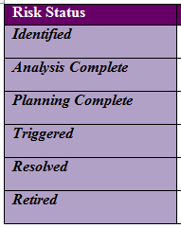
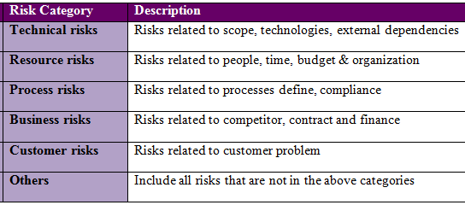

Slide 39
Risk report
Risk total: 39
Risk Status
Identified
Analysis Complete | 16
Planning Complete | 4
Triggered
Resolved | 5
Retired | 1
Very low | 17
Low | 4
Moderate | 3
High | 11
Very High | 4

